Slide 1
Negative Effects of Erosion

Slide 2
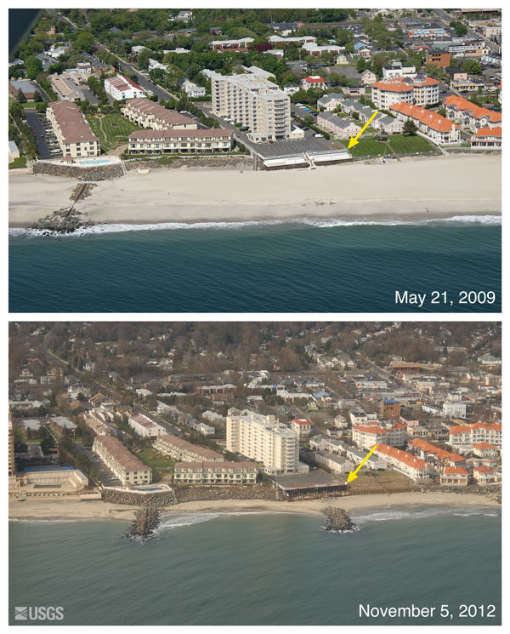
Slide 2
New Jersey Beach
2009 vs 2012
Notice a difference?!

Slide 3
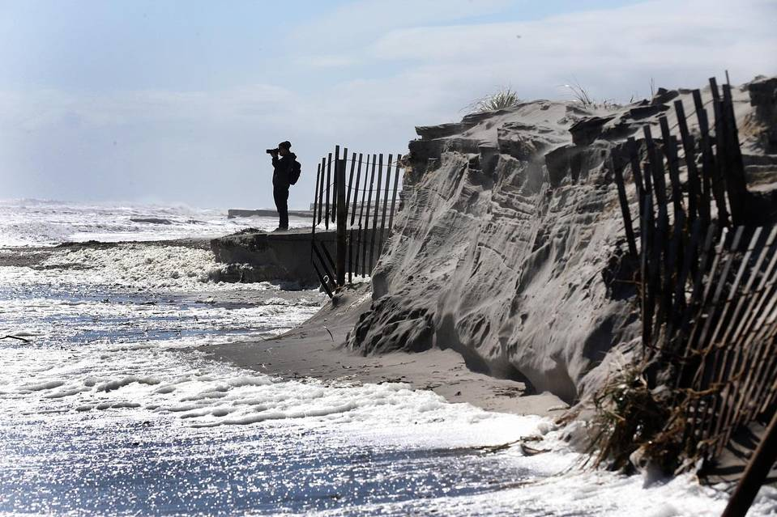
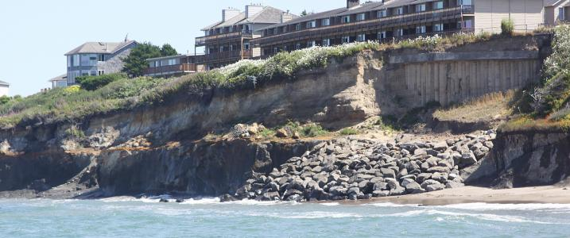
Pictures of
New Jersey Beaches:
Slide 3
Notes:
Slide 2

Slide 4
Slide 4
Watch these short news clips about NJ Beach Erosion:
http://www.fox29.com/news/282286249-video
http://www.mcall.com/news/nationworld/mc-jersey-shore-beach-erosion-20170125-story.html

Slide 5
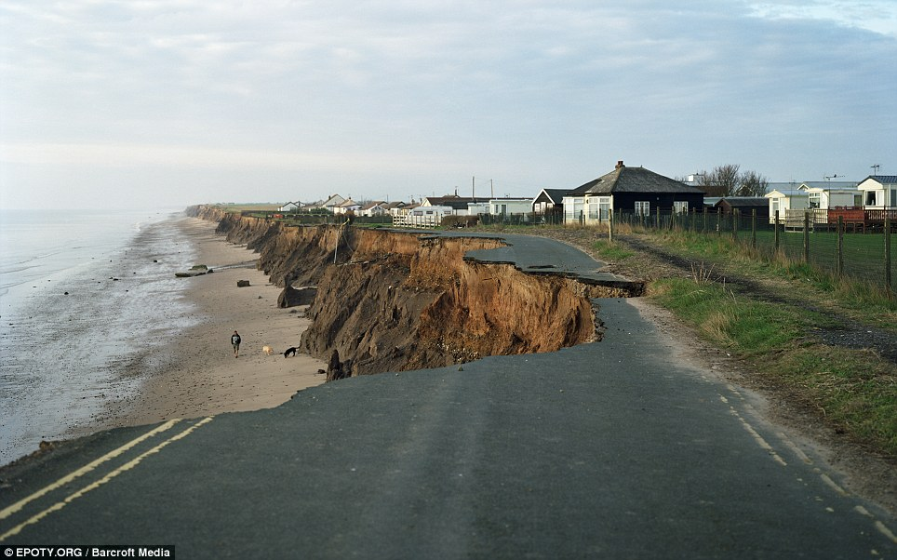
Slide 5: Erosion in Australia

Slide 6
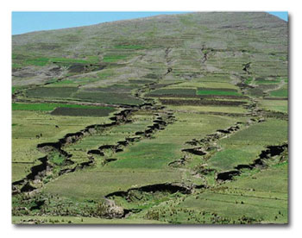
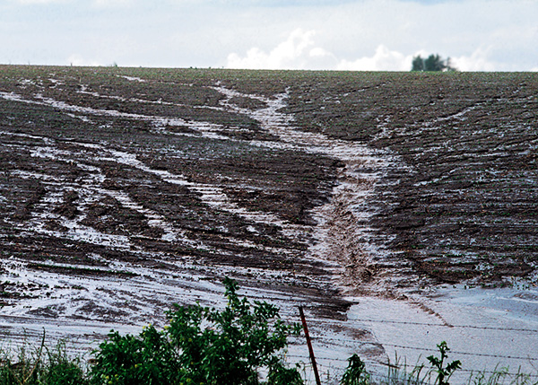
Slide 6: Effects of Erosion on Farmland

Slide 7
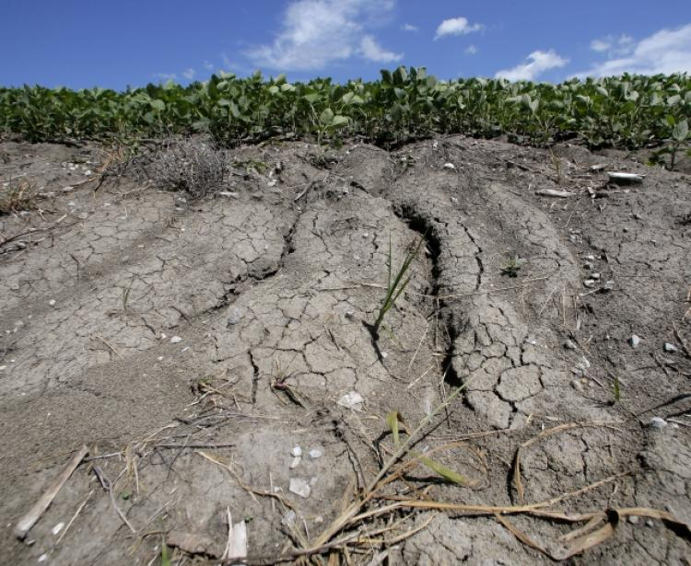
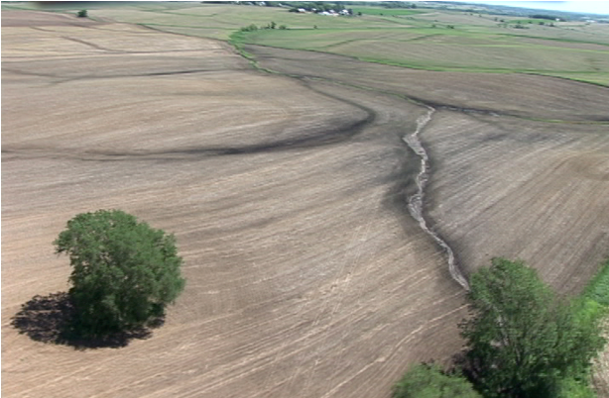
Slide 7: More Farmland Erosion

Slide 8
Slide 8:
Read the following article on the impact of erosion on the environment:
http://www.ehow.com/list_7481671_effects-soil-erosion-ecosystem.html
Learn about how humans are responsible for increasing erosion:
http://education.seattlepi.com/rates-erosion-increased-human-activities-5454.html

